Slide 1

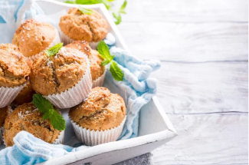
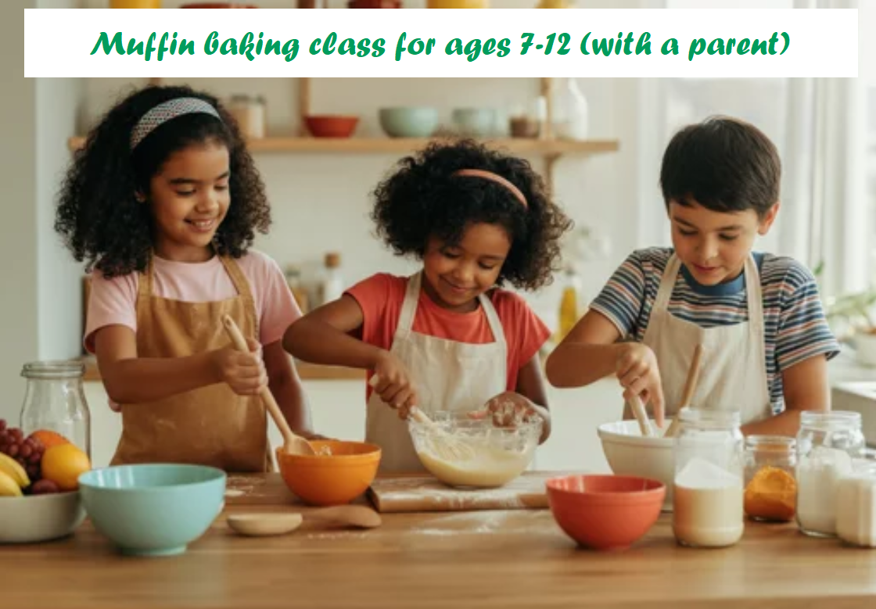


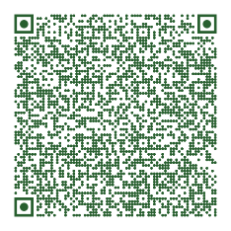

Baby, It's Cold Outside!
My hot cocoa is lonely.
It needs a warm muffin.
Food, Family, & Fun with 4-H!
Program:
4-H Muffin Baking Class
Date: December 15, 2025
Time: 4:00 – 6:00 p.m.
Ages: 7-12 (with a parent)
Register Online Here.
Location: The Rowser Building
Develop new skills - baking is FUN!
Get creative – be a maker!
Bake healthy snacks!
Learn about food safety, time management, and measuring.
➔ 1739 Richmond Hwy.
Stafford, VA 22554
⬅ scan for a map

